Slide 1
Lunch Launcher

Slide 2
TABLE OF CONTENTS
PROJECT HEADER
DESCRIPTION
REQUIREMENT AND ANALYSIS
CONTEXT LEVEL DFD
1ST LEVEL DFD
2ND LEVEL DFD
DATA DICTIONARY

Slide 3
Project Header
Online Food Ordering System for local restaurants

Slide 4
DESCRIPTION
The Online Food Ordering System is a local food and cooperative website. It provides convenience to the customers and overcomes disadvantages of the traditional queuing systems.
It gives restaurants the ability to increase their sales and expand their business.
With Online Food Ordering system, we can setup restaurant menu online and customers can also track their orders with few simple steps.

Slide 5
REQUIREMENT ANALYSIS
In some of the existing systems, Users must have a physical menu to order their food over a telephonic communication, this can often result into misunderstanding due to unclear communication through telephones.
What we have come up with is, an online ordering system which can be implemented anywhere with lower amount of capital costs. This system can be a proven solution for smaller cafes which do not have the ability or resources to come up with a personalized software.

Slide 6
FUNCTIONALITY
The Main advantage of our system is that it greatly simplifies the ordering process for both customers as well as the restaurants.
When the customer Logs-in, the system autmatically shows recommendations based on their previous orders or likings they have choosed at the time of registering with the website.
The customer can select any product and it will be added to his/her cart and pricings will be shown as soon as they are ready to place order.

Slide 7
The System decreases load on the restaurant , as the process is entirely automated.
Once an ‘Order’ is placed on the webpage, it is stored in the database and retrieved and then sent onto the desktop application at the restaurant's side in real-time.
Although there are systems available in the market, they are not dynamic and are designed for specific restaurants and specific geo-locations. This newly proposed system is free from all such barriers and it is dynamic as it can be modified as and when it is required

Slide 8
TYPES OF USERS
Admin
Vendors/ Restaurants
Customers

Slide 9
ADMIN FEATURES
Login
Manage Vendors/Restaurants
Manage Vendor's Products/Foods
Manage Customer
Manage Food Order Details
Manage Payment Details

Slide 10
VENDOR/RESTAURANT FEATURES
Create Account
Login
Add Food Details
Update Food Details
Delete Food
Check Food Orders
Update Food Delivery Status

Slide 11
CUSTOMER FEATURES
View Food Details
Register/Create Account
Login
Add to Cart
Update Cart
Checkout
Select Payment Option
Check Food Delivery Status

Slide 12
CONTEXT LEVEL /
0 LEVEL DFD

Slide 13
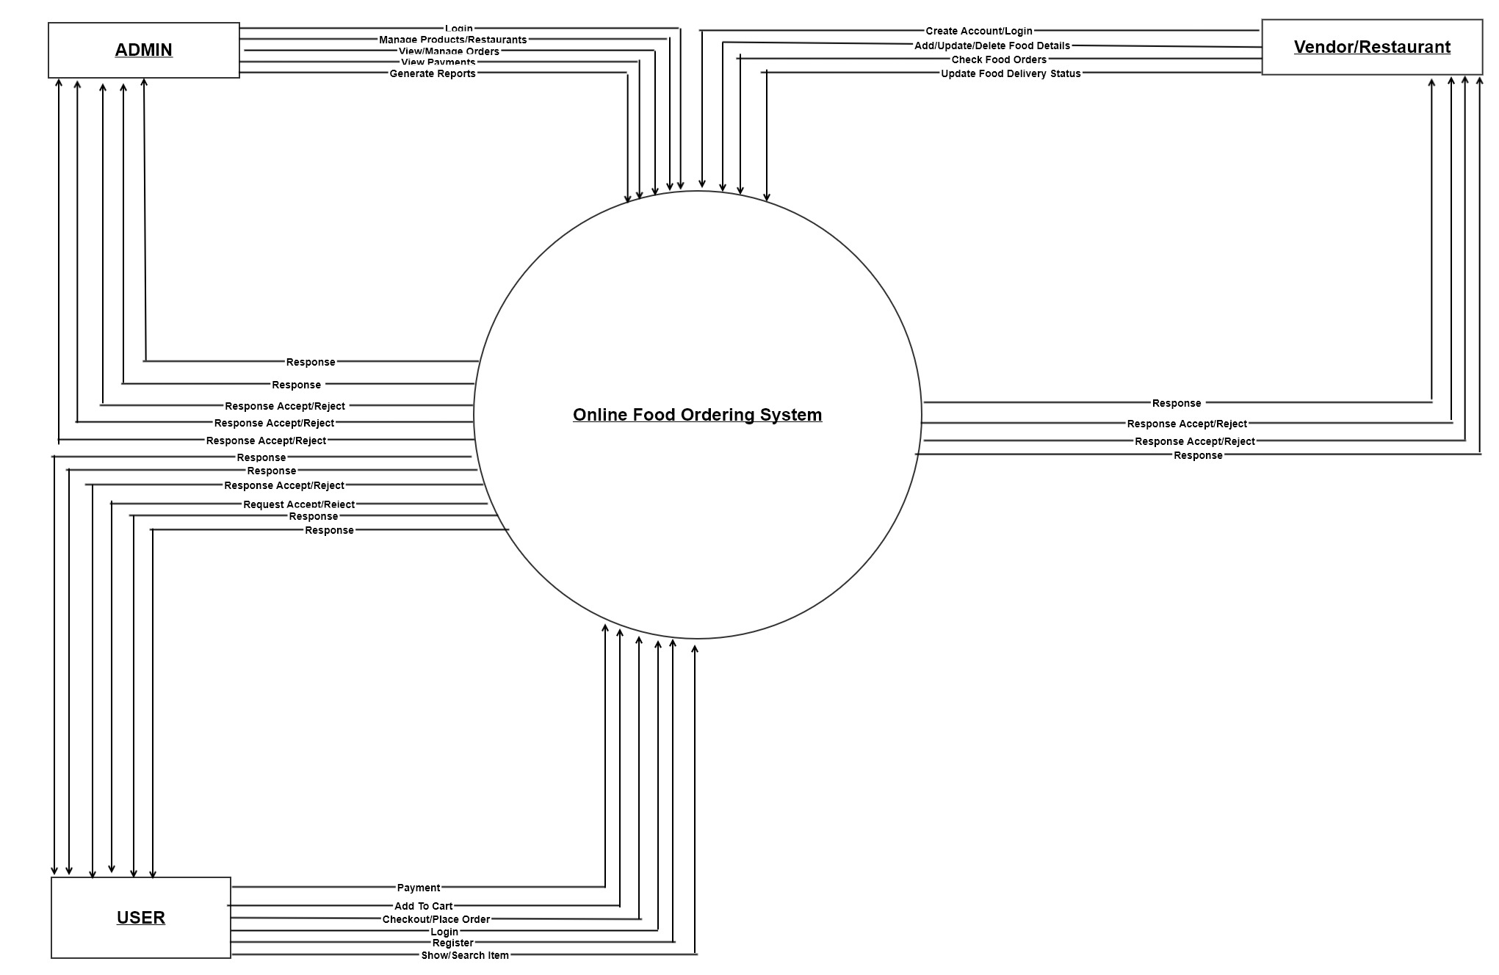

Slide 14
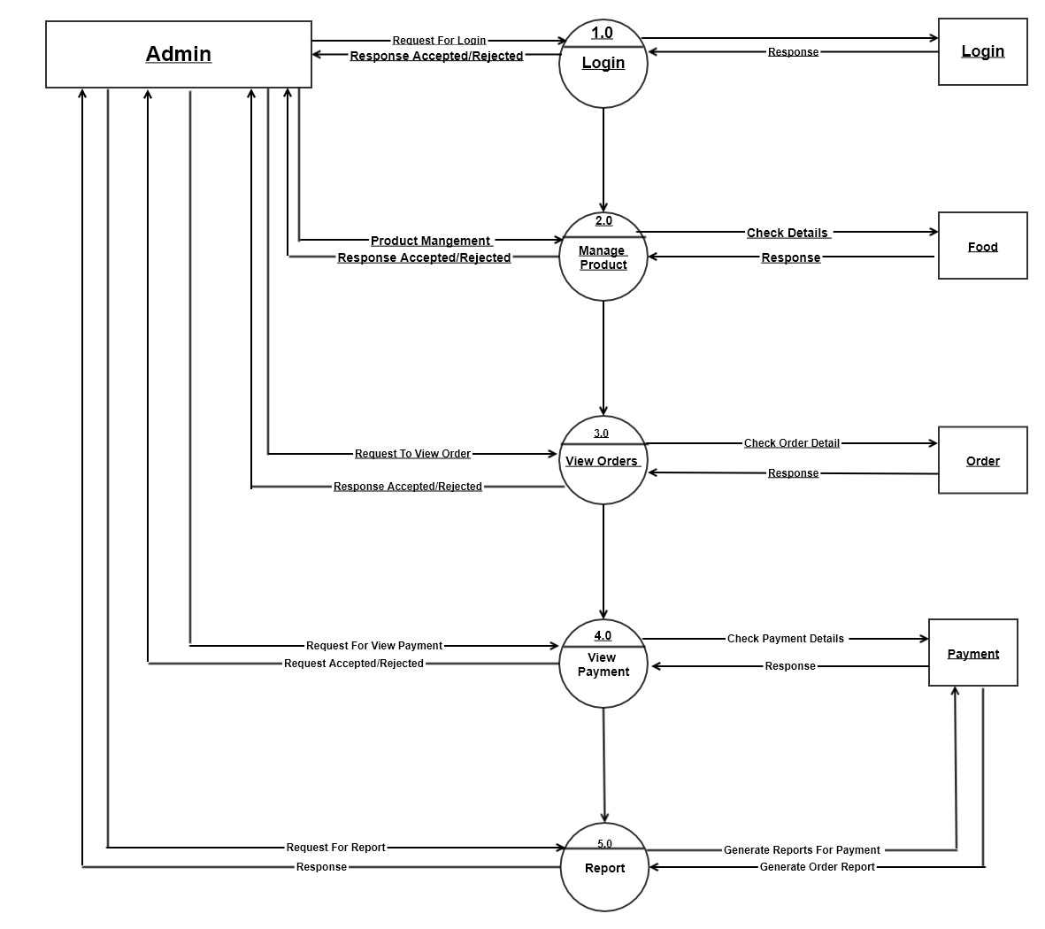
1ST LEVEL DFD
Admin Side

Slide 15
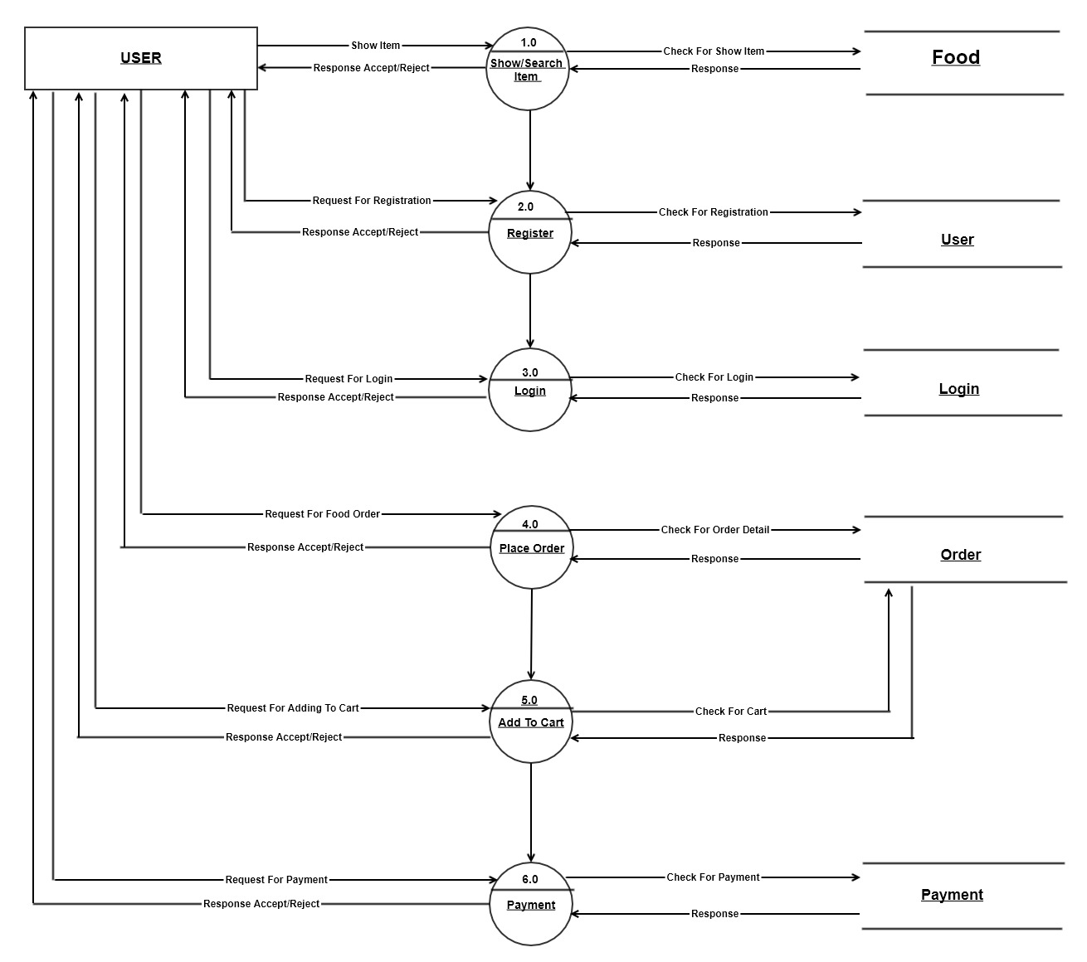
1ST LEVEL DFD
USER SIDE

Slide 16
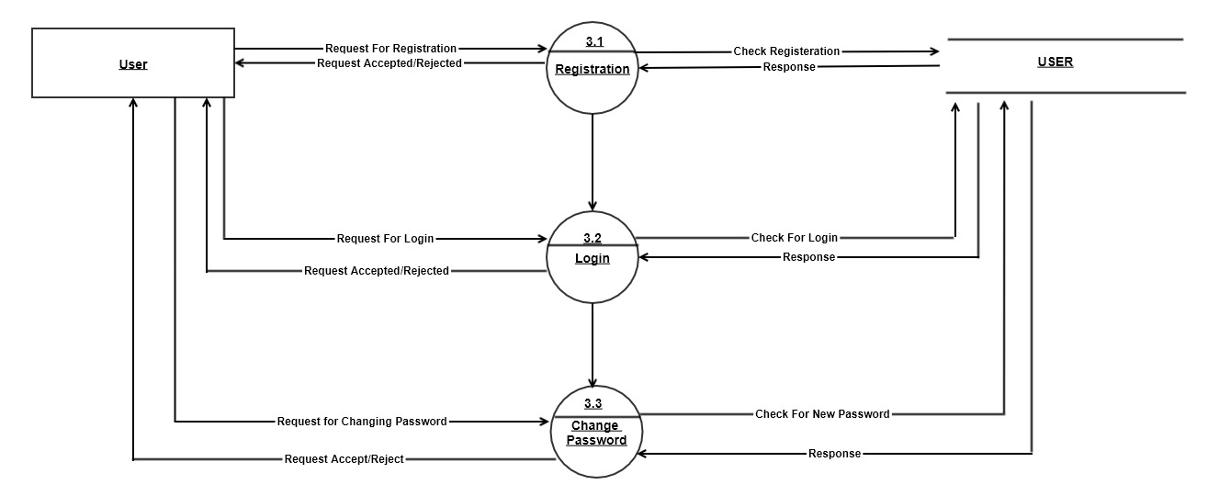
2ND LEVEL DFD
USER SIDE

Slide 17
DATA DICTIONARY
User
Field Name | Data Type | Size | Constraint | Description
U_ID | Integer | 10 | Primary Key | User ID
U_Name | Character | 25 | NotNull | User Name
U_MobileNo | Character | 10 | NotNull | User Mobile Number
U_Email | Character | 25 | Unique | User Email ID
DOB | Date | -- | NotNull | User Date Of Birth
U_Address | Character | 100 | NotNull | User Address

Slide 18
DATA DICTIONARY
Food
Field Name | DataType | Size | Constraint | Description
F_Item | Integer | 10 | Primary Key | Food Item Number
F_Name | VarChar | 25 | NotNull | Food Item Name
F_Price | Integer | 5 | Not Null | Food Item Price
F_Category | Integer | 3 | Foreign Key | Food Item Category

Slide 19
DATA DICTIONARY
Order
Field Name | DataType | Size | Constraint | Description
O_ID | Integer | 10 | Primary Key | Order ID
O_Customer | Integer | 10 | Foreign Key | Customer Number
O_Status _ID | Character | 10 | NotNull | Order Status
O_Date | Date | -- | NotNull | Order Date
O_Type | Integer | 10 | NotNull | Order Type
O_Pyt_ID | Integer | 10 | NotNull | Order Payment ID

Slide 20
DATA DICTIONARY
Login
Field Name | DataType | Size | Constraint | Description
L_ID | Character | 25 | Unique | Login ID
L_PWD | Character | 8 | NotNull | Login Password

Slide 21
DATA DICTIONARY
Payments
Field Name | Data Type | Size | Constraint | Description
P_ID | Integer | 10 | Primary Key | Payment ID
U_ID | Integer | 10 | Foreign Key | User ID
O_ID | Integer | 10 | Foreign Key | Order ID
P_Date | Date | -- | Not Null | Payment Date
P_Mode | Integer | 5 | Not Null | Payment Mode

Slide 22
DATA DICTIONARY
Restaurants
Field Name | DataType | Size | Constraints | Description
R_ID | Integer | 10 | Primary Key | Restaurant ID
R_Name | Character | 10 | Not Null | Restaurant Name
R_Address | Character | 100 | Not Null | Restaurant Address
R_Ratings | Integer | 5 | Not Null | Restaurant Ratings
R_Contact | Character | 10 | Not Null | Restaurant Contact Number

Slide 23
DATA DICTIONARY
Employee
Field Name | Data Type | Size | Constraint | Description
E_ID | Integer | 10 | Primary Key | Employee ID
E_Name | Character | 15 | NotNull | Employee Name
E_Address | Character | 100 | Not Null | Employee Address
E_City | Character | 10 | Not Null | Employee City
E_MobileNo | Character | 10 | Not Null | Employee Mobile Number

Slide 24
DATA DICTIONARY
Category
Field Name | Data Type | Size | Constraint | Description
C_ID | Character | 10 | Primary Key | Category ID
C_Name | Character | 25 | Not Null | Category Name

Slide 25
THANK YOU !
BY
18BCA086--Sourav Agrawal
18BCA088--Sahil Mansuri
18BCA132--Divyansh Jain

